Slide 1
PRAGMA13
Introduction to the Nimrod toolkit.
Worksheet at: http://docs.google.com/Doc?id=dhfsdmzq_81frj54q

Slide 2
Contents
Parametric computing
The Nimrod toolkit
Nimrod/G
Nimrod/O
Nimrod/E
Sequameters
Where to run Nimrod

Slide 3
Parametric computing
What is a job?
A job is an execution of a program on a computer
  Computers can be your own, or those provided by national and international computing infrastructure, e.g. PRAGMA testbed.
  A job takes parameters as inputs
Parametric computing runs multiple jobs with
varying parameters

Slide 4
Parametric computing
Why do you want to adjust parameters?
  to validate the model
  to explore the “parameter space”
  for non-deterministic models to average over an ensemble
  to find the parameters that optimise some result
  to find which parameters have the most effect

Slide 5
The Nimrod toolkit
The Nimrod toolkit is an extensive parameter exploration toolkit with grid computing support
Tools such as Nimrod/G, Nimrod/O and Nimrod/E aid with parameter exploration
Nimrod gives access to the computational Grid which facilitates more jobs and thus a finer resolution of the parameters
All this is done through a web portal

Slide 6
The Nimrod toolkit
Previous Nimrod Applications:
  weather/pollution models
  climate models
  economic models
  drug design
  “in silico” biology
  human behaviour
  simulation of materials
  geophysical models
  astronomy models
  mechanical design
  electromagnetic models
  experimentation in pure mathematics

Slide 7
Nimrod/G
Nimrod/G supports
  Sweeps over a given parameter space
  And Monte Carlo experiments
Execution and Results
  Nimrod executes programs and copies files
  All this is declared in a task script

Slide 8
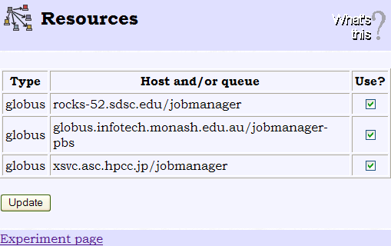

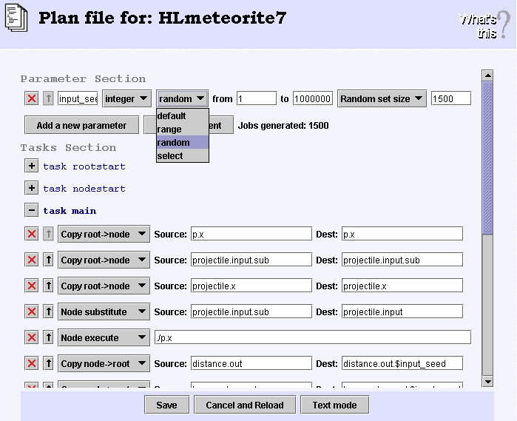
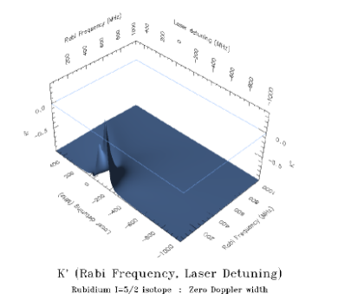
How does a user develop an application using Nimrod?
Job 1
Job 2
Job 3
Job 4
Job 5
Job 6
Job 7
Job 8
Job 9
Nimrod will run the jobs on the computers you have selected
Job 10
Job 11
Job 12
Select the computers to run on
Job 13
Job 14
Job 15
Nimrod will create multiple jobs with different parameter sets
Job 16
Job 17
Job 18
The results are copied back to the Nimrod server for you to analyse
Create a Nimrod plan file (script) specifying the parameters

Slide 9
Case study: Simulation of Meteorite Accretion
Dr Kurt Liffman
  Centre for Stellar and Planetary Astrophysics (CSPA) at Monash University
  http://www.cspa.monash.edu.au
“The code models the early solar system, where the protoSun is surrounded by an accretion disc, which we call the solar nebula…”
We will execute this program about 10,000 times exploring about five million particles

Slide 10
Nimrod Plan file - Meteorite
The second part normally contains the main task. This task is executed once for each parameter set. In this case, 10,000 times
The main task can start with copying files to the execution computer. In this case, the program and some data files
parameter input_seed integer random from 1 to 1000000 points 10000;
task main
copy p.x node:p.x
copy projectile.input.sub node:projectile.input.sub
copy projectile.x node:projectile.x
substitute projectile.input.sub projectile.input
node:execute ./p.x
copy node:distance.out distance.out.$input_seed
copy node:temperature.out temperature.out.$input_seed
copy node:error.out error.out.$input_seed
copy node:disk.out disk.out.$input_seed
copy node:density.out density.out.$input_seed
copy node:initial_particle.out initial_particle.out.$input_seed
copy node:ejected_particle.out ejected_particle.out.$input_seed
copy node:stopped_particle.out stopped_particle.out.$input_seed
endtask
The first part of the Nimrod plan specifies the parameters Nimrod will adjust. In this example, there are 10,000 random seeds.
The last part copies result files back to the Nimrod server.
Nimrod can substitute the parameters into an application’s input parameter file
This command executes the program. It can be a program copied over (as above), or one already install on the computer
Further options can be added below to perform parameter optimisations or experimental designs.

Slide 11
Case study 2: bead
Andrew Lewis and Seppo Saario
  Griffith University
“Design of a test rig for a mobile phone antenna. Determine dimensions and properties of a ceramic bead that optimise antenna gain.”
This involves about 15,000 jobs

Slide 12
Nimrod Plan file - bead
parameter p integer range from 35 to 60 step 1;
parameter q integer range from 2 to 17 step 1;
parameter r integer range from 15 to 45 step 1;
task main
  copy bead.data node:bead.data
  copy beader node:beader
  node:execute ./beader $p $q $r > final
  copy node:final output.$jobname
endtask
Another notable difference is that this program inputs the parameters on the command line, rather than an input file
Similar example as before, but exploring multiple parameters. Performing a full sweep, this will create 14,508 jobs (26 x 16 x 31)

Slide 13
Nimrod/O
Optimisation is finding the parameter set for the best value of some aspect of the output
Nimrod/O supports various optimisation algorithms:
  GA, Simplex, Simulated annealing… etc…
Execution and Results
  Same scripting support as Nimrod/G

Slide 14
Optimisation
Can be use for:
  Maximise or minimise output
    E.g. engineering design
  Inverse computational problems
    To find the input parameters that produce a given output

Slide 15
Optimisation - Maximise or minimise output
Cycle of jobs until optimal result is obtained
Nimrod/O
Results
Results
Results

Slide 16

Optimisation - Inverse computational problems
Cycle to minimise the difference between the “results” and the “ideal result”
Nimrod/O
Results
Ideal result
Results
Results
f(x)
Compare
Model evaluation can be done by a function or by user interaction

Slide 17
Nimrod/E
Experimental Design
Nimrod/E supports
  Fractional Factorial Design
  Analysis tools
Execution and Results
  Same script support as Nimrod/G and Nimrod/O

Slide 18
Nimrod/E
Full parameter sweep may produce very many jobs
Nimrod/ED uses experimental design techniques to select appropriate subset of full sweep
Nimrod/EA analyses results of reduced experiment – identifies significant parameters
Nimrod/G
Nimrod/ED
Nimrod/EA
Lenth plot

Slide 19
Example: Cardiac Modelling
Flow of calcium ions in heart muscle cells
Ania Sher
  Oxford University
Differential equation model solved using Matlab
Model uses 19 parameters
Parameter sweep with 2 levels per parameter gives 524,288 jobs
Experimental design (resolution V) reduces this to 512 jobs

Slide 20
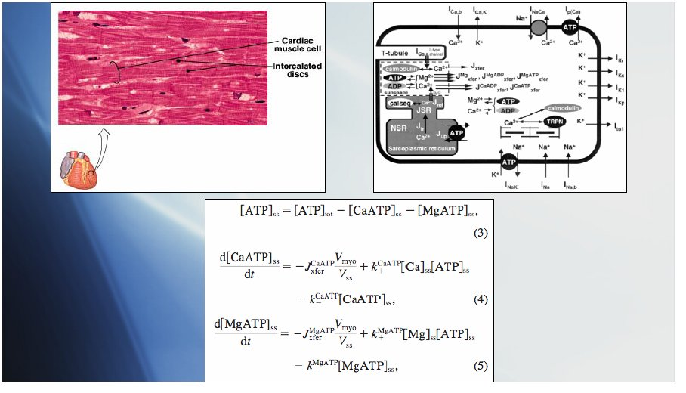
Cardiac Modelling (cont)
Each cell in the heart …
Which parameters are having the biggest affect on the results?
… can be represented by the chemical reactions inside and the interactions with other cells
The reactions and interactions are modelled with differential equations

Slide 21
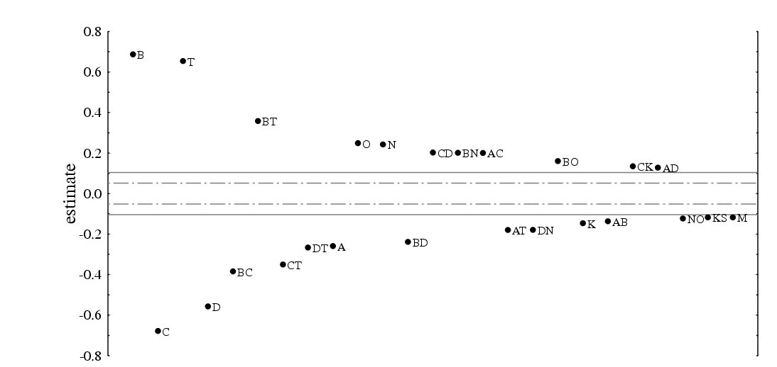
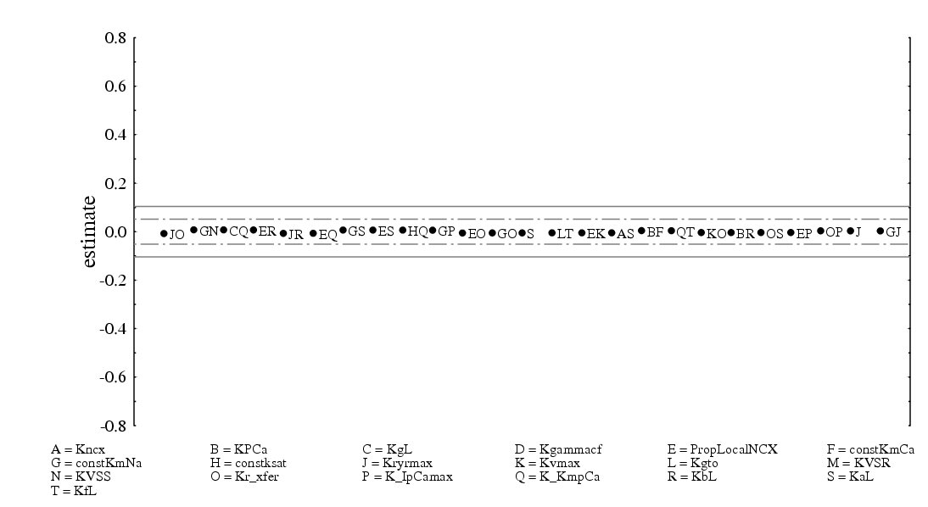
Cardiac Modelling - Nimrod/E results
These parameters and parameter combinations have a significant effect on the output
These parameters and parameter combinations have no significant effect on the output

Slide 22
Sequameters: incorporating independent workflows in a sweep
…

Slide 23
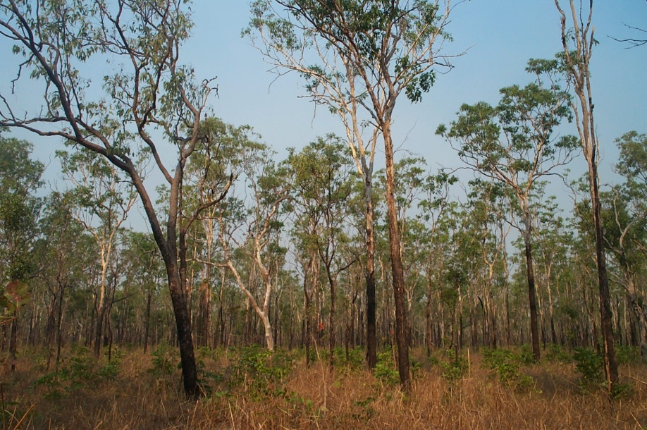
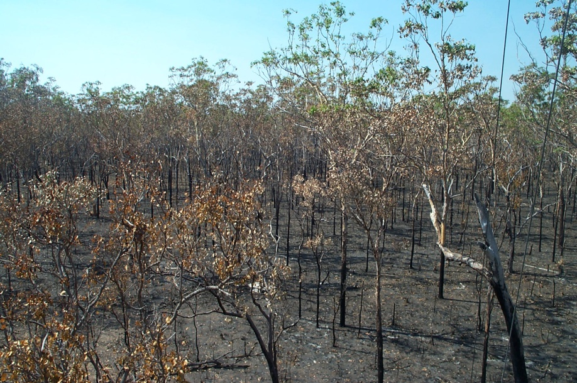
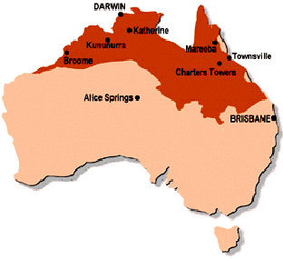
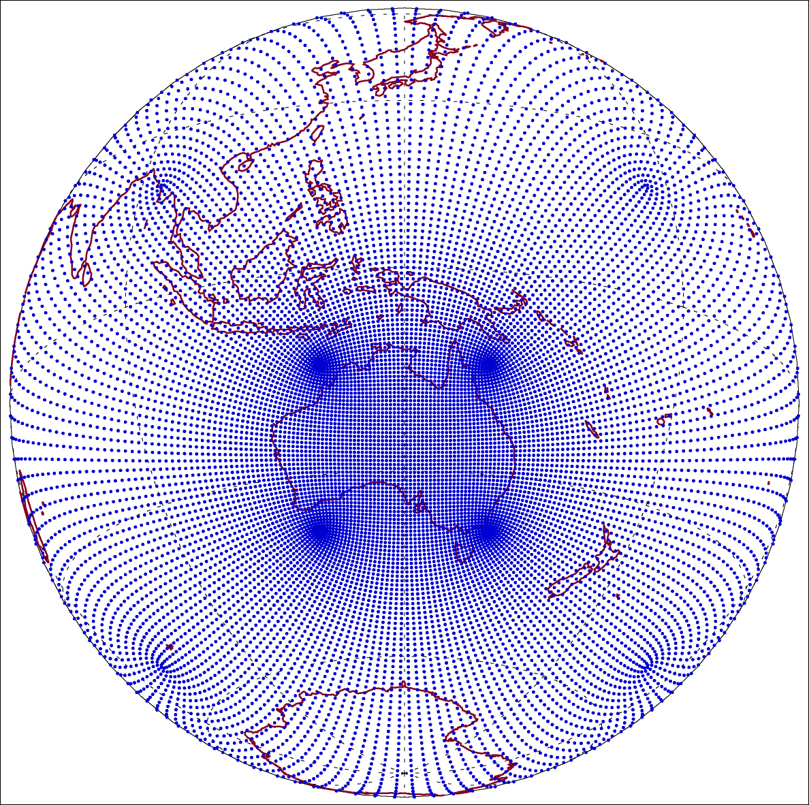
Motivation
Extensive savanna eco-systems in northern Australia
Changing fire regime
Fires lead to abrupt changes in surface properties
  Surface energy budgets
  Partititioning of convective fluxes
  Increased soil heat flux
  Modified surface-atmosphere coupling
Sensitivity study: do the fire’s effects on atmospheric processes lead to changes in highly variable precipitation regime of Australian Monsoon?
Many potential impacts (e.g. agricultural productivity)
(J. Beringer)
K. Görgen, A. Lynch, C. Enticott, J. Beringer, D. Abramson, P. Uotila, N. Tapper

Slide 24
Experiment Design
Combination of atmospheric modelling (C-CAM), re-analysis and observational data
C-CAM Simulations
1974 to 1978
1979 to 1999
spinup
control run, no fires / succession
Part I
real fires / succession, selected scenarios
Part II
~ 90 independent runs (fire / succession scenarios)
for sensitivity studies → 1890 yrs of simulations
K. Görgen, A. Lynch, C. Enticott, J. Beringer, D. Abramson, P. Uotila, N. Tapper

Slide 25
The base plan file
parameter expnr integer range from 1 to 90 step 1;
task main
copy root:cms.${expnr}.start.tar.gz .
copy root: vf_ccam.* .
: :
: :
: :
copy node: cms.${expnr}.finish.tar.gz root:.
endtask

Slide 26
Task Management Issues
Network Failures
Application Failures
Application Life Span
Resource Failures
6 weeks

Slide 27

Task Splitting
90 Parameterized Instances
Sequential Jobs

Slide 28
Adding task splitting to the plan file
parameter expnr integer range from 1 to 90 step 1;
seqameter timestep integer range from 1 to 252 step 1;
task main
inputs cms.${expnr}.$[$timestep -1].tar.gz vf_ccam.$timestep
output cms.${expnr}.${timestep}.tar.gz on create f1
sequemeters timestep; parameters expnr
: : :
: : :
endtask

Slide 29
More information
The Nimrod WWW pages:
  www.csse.monash.edu.au/~davida/nimrod
How to get an account:
  nimrod.grid.apac.edu.au/APACNimrodDoc.html

